Slide 1

C Developer
File Handling

Slide 2

Course Objectives
Understand the usefulness of being able to store data other than temporarily
Know the different ways of reading and writing in a file

Slide 3

Course Plan
1. Opening and Closing Files
2. Read and Write Operations

Slide 4

1. Opening and Closing Files

Slide 5

1. Opening and Closing Files
Overview
It is necessary to keep data in memory in a permanent way
For the moment, our data is only available during the execution of the program
A file will thus be a support to keep a bulk of data

Slide 6
1. Opening and Closing Files
Overview
Text file: representation of a file as a sequence of lines, each composed of a certain number of characters and terminated by “\n”
Binary file: sequence of bytes, which can represent all kinds of data

Slide 7
1. Opening and Closing Files
Overview
The program does not read/write its information directly from/to the file: it passes through a buffer
This buffer is emptied automatically when it is full, or when it contains the character “\n”
It can be explicitly dumped with the fflush function
#include <stdio.h>

Slide 8
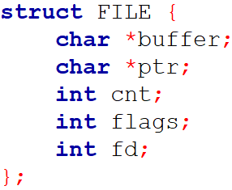
1. Opening and Closing Files
Overview
The memory location of the input/output buffer of a file is given by a variable of FILE type.
It is a structure defined in stdio.h

Slide 9
1. Opening and Closing Files
Overview
To access a file, we declare a pointer to the FILE type
The function to open a file will assign to this pointer the address of a variable of FILE type containing information about the file

Slide 10
1. Opening and Closing Files
Opening a file
We use the fopen function which returns a pointer to the FILE type
To do this we pass it two arguments: the name of the file and the opening mode
If the opening failed, the returned pointer is NULL
We will check that this opening has been successful: to do so, we must just test the value of the pointer

Slide 11
1. Opening and Closing Files
Opening a file
Function signature:
– filename: is the name of the file to open, possibly prefixed by the path
– accessMode: specifies both the access mode (read, write, append) and the opening mode (ASCII or binary)

Slide 12
1. Opening and Closing Files
Opening a file
The different access modes:
– “r” read: you can read the contents of the file but not write to it, the file must exist before
– “r+” read extended (read and write): you can read the contents of the file and write to it, the file must exist before
In both cases, if the file does not exist, fopen returns the NULL pointer

Slide 13
1. Opening and Closing Files
Opening a file
The different access modes:
– “w” write: the content of the file is deleted, you can then write but not read
– “w+” write extended (read and write): the content of the file is deleted, you can then write and read
In both cases, if the file does not exist, it is created

Slide 14
1. Opening and Closing Files
Opening a file
The different access modes:
– “a” append: the content of the file is kept, so you can write to the end of it but not read
– “a+” append extended (read and append): the content of the file is kept, so you can write to the end of it and read
In both cases, if the file does not exist, it is created

Slide 15
1. Opening and Closing Files
Opening a file
The previous access modes are ASCII opening modes
Their equivalents in binary opening mode are: “rb”, “rb+”, “wb”, “wb+”, “ab”, and “ab+”
If you do not specify a path when you use the fopen function, your file will have to be (or will be) placed in the same directory as your project (or in the execution path)

Slide 16
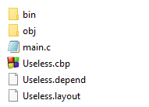
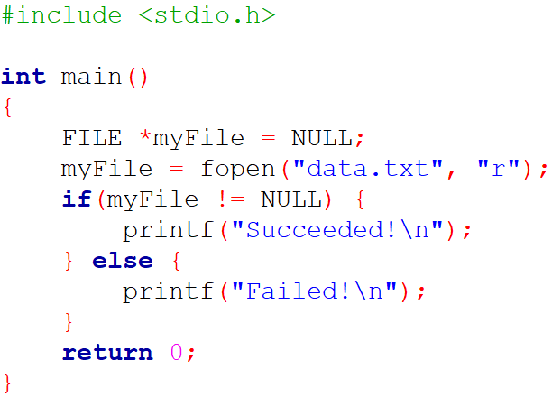

1. Opening and Closing Files
Opening a file

Slide 17

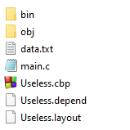

1. Opening and Closing Files
Opening a file

Slide 18

1. Opening and Closing Files
Opening a file
And if you run directly from the \bin\Debug executable folder:

Slide 19
1. Opening and Closing Files
Closing a file
We use the fclose function which returns a value of int type, and which takes as a parameter a pointer to the FILE type
If the closing has failed, the returned value is EOF, otherwise it is 0
EOF is a symbolic constant defined in stdio.h, a failure corresponds most of the time to a file already closed or non-existent
We check that this closing was successful: it is enough to test the value of the returned integer

Slide 20
1. Opening and Closing Files
Closing a file
Closing a file will empty the write buffer: useful in case of later abnormal program interruption
This also allows to free memory by deleting the dynamic variable of FILE type created at the opening of the file (fclose calls the free function)

Slide 21
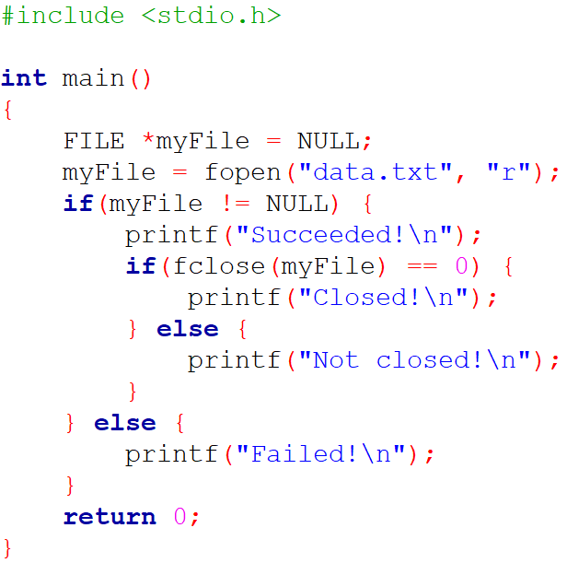

1. Opening and Closing Files
Closing a file

Slide 22
1. Opening and Closing Files
Renaming a file
Use the rename function
Function signature:
– The parameters are the old name of the file and its new name
– This function returns 0 if it succeeded in renaming the file and -1 otherwise

Slide 23
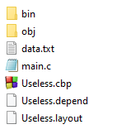
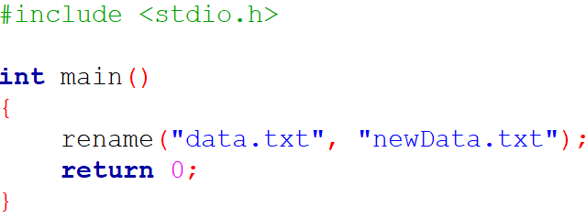
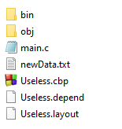
1. Opening and Closing Files
Renaming a file

Slide 24
1. Opening and Closing Files
Removing a file
Use the remove function
Function signature:
– The only parameter is the name of the file to delete
– This function returns 0 if it succeeded in removing the file and -1 otherwise
The deletion is definitive, it is not a move to the Recycle Bin

Slide 25
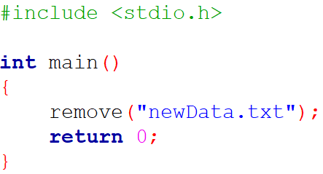
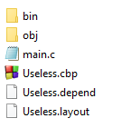
1. Opening and Closing Files
Removing a file

Slide 26

1. Opening and Closing Files
Questions

Slide 27

2. Read and Write Operations

Slide 28
2. Read and Write Operations
Writing
To write a character, use the fputc function
Function signature:
– It takes as parameter the character to write, and a pointer to the file in which we want to write
– The returned value is equal to the value of the written character or to EOF in case of failure

Slide 29
2. Read and Write Operations
Writing
The failure causes can for example be an attempt to write in a closed file, or in a non-existent file
We can therefore test the proper functioning of our operation
The pointer in parameter is obviously the pointer to the FILE structure which has been returned by the fopen function

Slide 30
2. Read and Write Operations
Writing
Writing is done at the current position if the file was opened in write mode, this position is incremented by 1 at the end of this operation (when opening, the current position is the beginning of the file)
Writing is done at the end of the file if it was opened in append mode

Slide 31
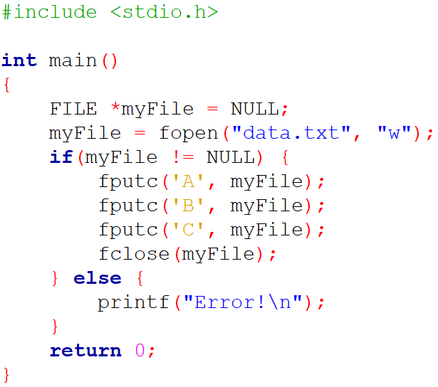

2. Read and Write Operations
Writing

Slide 32
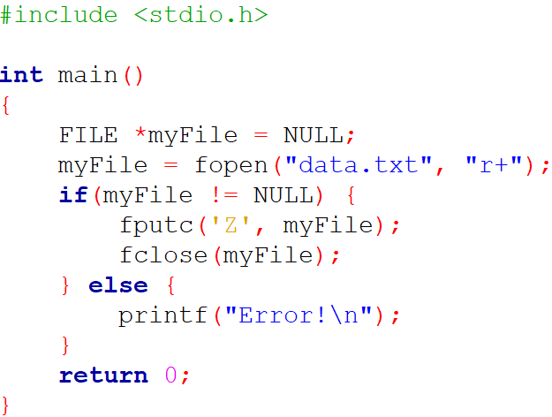

2. Read and Write Operations
Writing

Slide 33
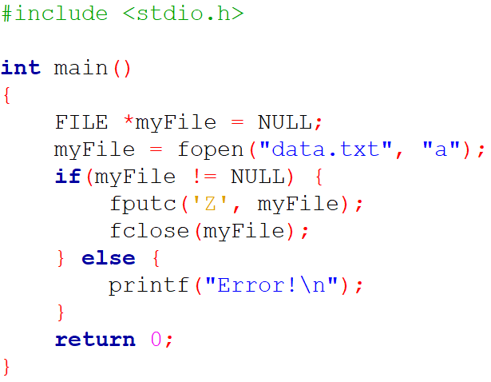

2. Read and Write Operations
Writing

Slide 34
2. Read and Write Operations
Writing
To write a string, use the fputs function
Function signature:
– It takes as parameter the string to write, and a pointer to the file in which we want to write
– The returned value is equal to the written string or to EOF in case of failure
Writing is done the same way (as fputc) except that the position is incremented by the string size; the “\0” terminal is not considered

Slide 35
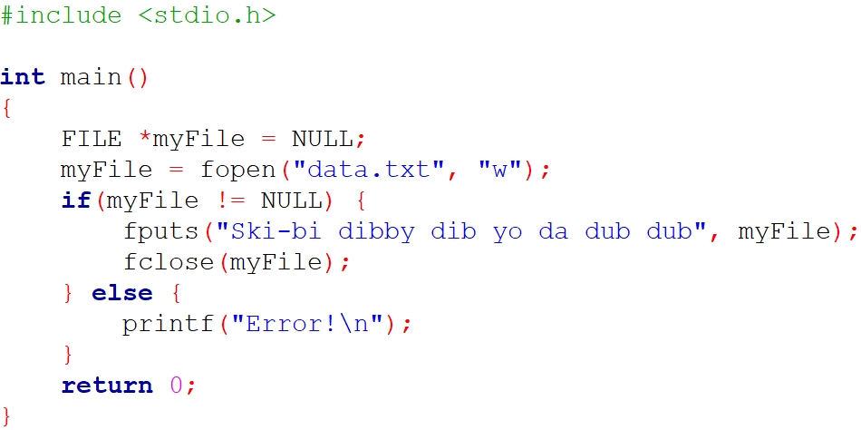

2. Read and Write Operations
Writing

Slide 36
2. Read and Write Operations
Writing
To write a formatted string, use the fprintf function
Function signature:
– It takes as parameter a pointer to the file in which we want to write, the formatted string to write, and the different values
– The returned value is equal to the number of characters written or to EOF in case of failure
Writing is also done the same way (as fputs) and the position is incremented by the number of characters written

Slide 37
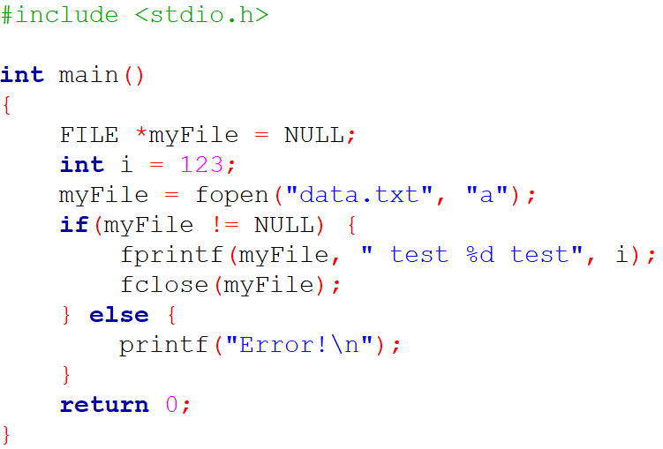

2. Read and Write Operations
Writing

Slide 38
2. Read and Write Operations
Reading
To read a character, use the fgetc function
Function signature:
– It takes as parameter the file in which we want to read
– The returned value is equal to the value of the character or to EOF in case of failure

Slide 39
2. Read and Write Operations
Reading
Reading is done at the current position
This position is incremented by 1 at the end of this operation (when opening, the current position is the beginning of the file)

Slide 40
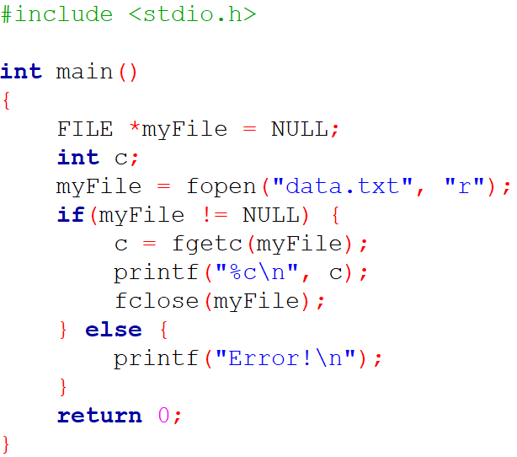

2. Read and Write Operations
Reading

Slide 41
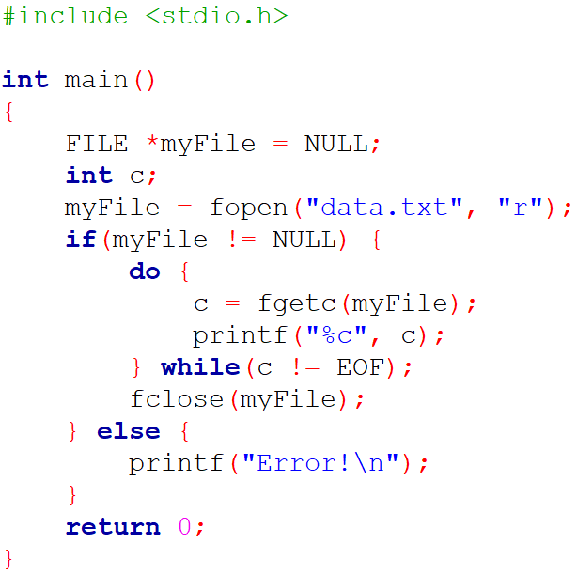
2. Read and Write Operations
Reading

Slide 42
2. Read and Write Operations
Reading
To read a string, use the fgets function
Function signature:
– It takes as parameter an array of char intended to receive the read string, an integer corresponding to the maximum number of characters to read + 1, and a pointer to the file in which we want to read
– The returned value is equal to the read string or to EOF in case of failure

Slide 43
2. Read and Write Operations
Reading
Reading is done the same way (as fgetc) except that the position is incremented by the number of read characters: equal to length-1 or less if we met “\n” or EOF
If we want to read 10 characters, length must be set to 11, in order to leave a space for the “\0” terminal

Slide 44
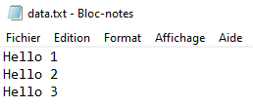
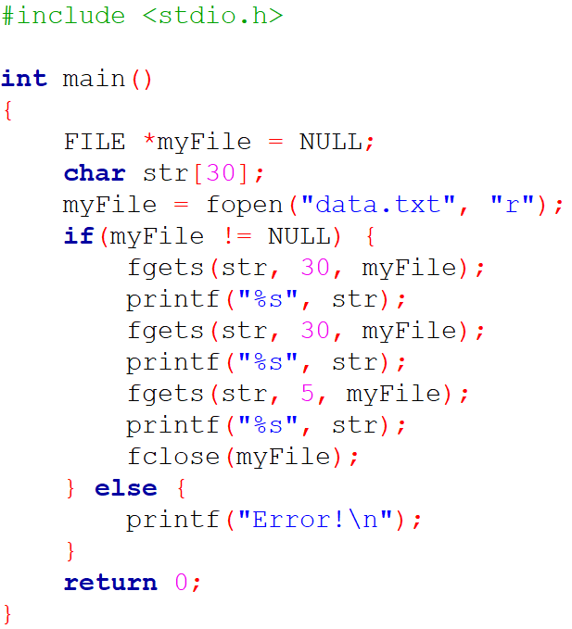
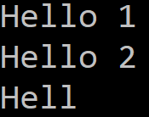
2. Read and Write Operations
Reading

Slide 45
2. Read and Write Operations
Reading
To read a formatted string, use the fscanf function
Function signature:
– It takes as parameter a pointer to the file in which we want to read, the formatted string to read, and the different variables
– The returned value is equal to the number of characters read or to EOF in case of failure
Reading is also done the same way (as fgets) and the position is incremented by the number of characters read

Slide 46

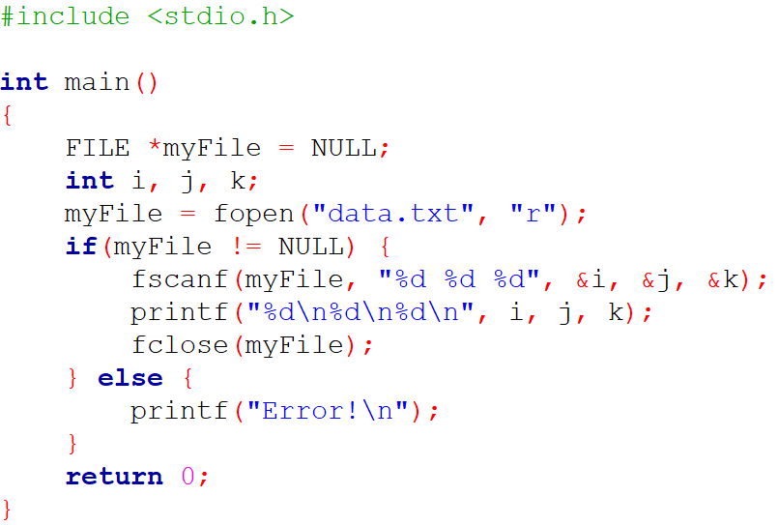

2. Read and Write Operations
Reading

Slide 47
2. Read and Write Operations
Moving in a file
Considering the previous operations, when a file has been opened, there is a pointer that indicates the current position in the file
We will be able to know its value, and modify it manually

Slide 48
2. Read and Write Operations
Moving in a file
To get the current position in the file, use the ftell function
Function signature:
– It takes as parameter a pointer to the file
– It returns the current value of the position indicator or -1 in case of failure

Slide 49
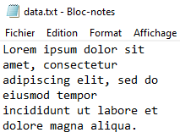
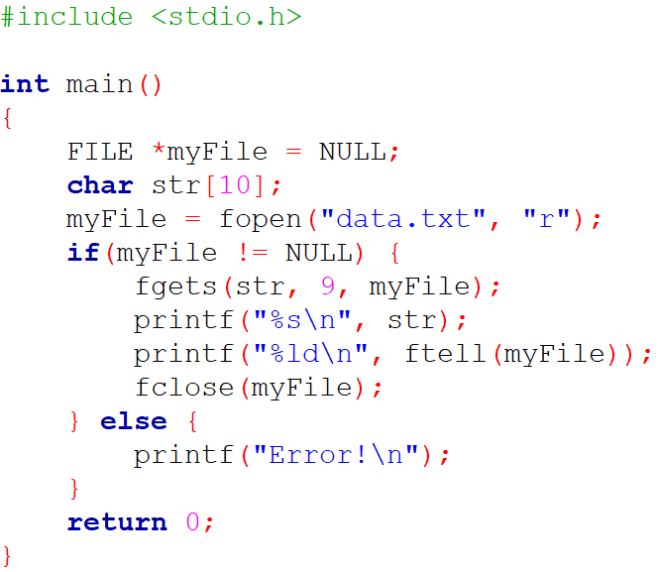

2. Read and Write Operations
Moving in a file

Slide 50
2. Read and Write Operations
Moving in a file
To set the position in the file, use the fseek function
Function signature:
– It takes as parameter a pointer to the file, an offset (positive or negative) from a reference position, and the reference position
– It returns 0 or -1 in case of failure

Slide 51

2. Read and Write Operations
Moving in a file
whence constants:
– SEEK_SET: beginning of the file
– SEEK_CUR: current position of the file pointer
– SEEK_END: end of the file

Slide 52
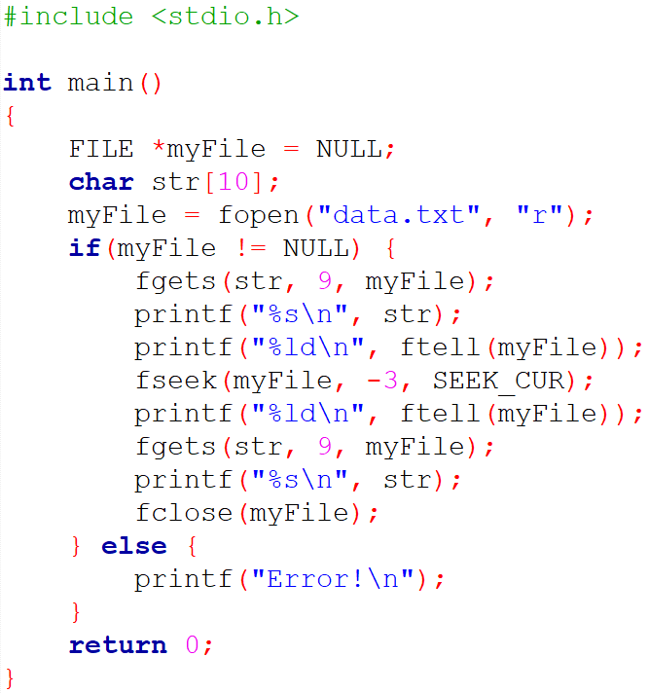
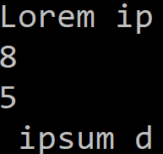
2. Read and Write Operations
Moving in a file

Slide 53
2. Read and Write Operations
Moving in a file
To go back to the beginning of the file, you can also use the rewind function
Function signature:
– It takes as parameter a pointer to the file
– Unlike the fseek function used with SEEK_SET, it does not return any value and therefore cannot be tested

Slide 54
2. Read and Write Operations
Questions

Slide 55

C Developer
File Handling
Thank you for your attention

